Slide 1

Applied Use Cases of the Health-RI Semantic Interoperability Initiative
Pedro Paulo F. Barcelos, Niek van Ulzen, Reinier Groeneveld,
Ana Konrad, Douwe Spaanderman, and Shuxin Zhang
Notes:
Welcome. In this presentation, I will walk you through applied use cases from the Health-RI Semantic Interoperability Initiative.
The focus is on how semantic technologies can support practical decisions in health data reuse. Rather than discussing interoperability in the abstract, we will follow concrete user stories and show how meaning can be made explicit, compared, validated, and reused across datasets.

Slide 2

Primary User Roles
Dr. Amir Hassan — Researcher
Inge de Boer — Data Steward
Notes:
To make the examples easier to follow, we introduce two primary user roles.
The first is Dr. Amir Hassan, a researcher who wants to reuse health data responsibly for analysis.
The second is Inge de Boer, a data steward who is responsible for making sure that data elements are described, mapped, and published in a consistent and reliable way.
Together, these two roles represent both sides of semantic interoperability: the person who needs to find and interpret data, and the person who helps make that data understandable and reusable.

Slide 3
Amir Hassan: Research Goal and Challenge
Amir is studying whether treatment outcomes differ across patient groups and needs to stratify his cohort using the correct sex/gender-related variable.
Before requesting data, he must identify which datasets contain the right concept and whether those variables are semantically compatible across institutions.
Dr. Amir Hassan — Researcher
Inge de Boer — Data Steward
Notes:
We begin with Amir’s perspective.
Amir is studying whether treatment outcomes differ across patient groups. To do that, he needs to stratify his cohort using the correct sex- or gender-related variable.
At first, this may sound straightforward. Many datasets contain variables that appear to describe sex or gender.
But before Amir can request and combine data, he needs to know which datasets contain the concept he actually needs, and whether similar variables are defined in the same way across institutions.
This is the central challenge: the labels may look familiar, but the underlying meanings may not be the same.

Slide 4
Amir’s End-to-End Workflow
Scenario 1: Clarify Meanings Before Reuse
Scenario 2: Identify the dataset that represents the right meaning
Result:
Amir could move from label-based guessing to query-supported reuse decisions, using meanings, mappings, and inferred knowledge to identify relevant variables, compare related concepts, and understand which ones align, partially overlap, or should not be reused together.
Scenario 3: Use Mappings to Connect Data and Infer Reuse Knowledge
Scenario 4: Query Semantic Knowledge Across Variables and Meanings
Notes:
This is Amir’s end-to-end workflow.
The workflow follows the steps Amir needs to take before he can make a defensible decision about data reuse. His goal is to move from label-based guessing to evidence-based interpretation.

Slide 5
Scenario 1: Clarify Meanings Before Reuse
Scenario 1: Clarify Meanings Before Reuse
Scenario 2: Identify the dataset that represents the right meaning
Result:
Amir could move from label-based guessing to query-supported reuse decisions, using meanings, mappings, and inferred knowledge to identify relevant variables, compare related concepts, and understand which ones align, partially overlap, or should not be reused together.
Scenario 3: Use Mappings to Connect Data and Infer Reuse Knowledge
Scenario 4: Query Semantic Knowledge Across Variables and Meanings
Notes:
We now move into the first applied scenario: clarifying meanings before reuse.
This is the starting point for Amir’s work. Before selecting or combining any datasets, he needs to understand the landscape of related concepts.
Although sex- and gender-related variables may appear similar at first glance, they can be based on very different aspects of a person’s identity or record, including biological characteristics, social identity, legal status, or the perspective of the person or institution defining the information.
At this step, Amir is trying to understand what is out there: which sex- and gender-related meanings are represented in the available datasets, how they differ from one another, and which one best matches what he needs for his study.

Slide 6






Available Sex and Gender Variables by Dataset
patient_id | care-sm:Sex ("Biological sex"@en) | birth_year | residence_code
NPR-001 | female | 1987 | 0363
NPR-002 | male | 1979 | 0599
NPR-003 | female | 1994 | 0518
NPR Demographic Extract
person_id | hri-openehr:legal-gender ("Legal gender"@en) | encounter_id | record_date
NMC-001 | female | ENC-7001 | 2026-01-14
NMC-002 | male | ENC-7002 | 2026-01-15
NMC-003 | nonbinary | ENC-7003 | 2026-01-16
Hospital Registration Extract
intake_id | loinc:107454-1 ("Administrative gender"@en) | questionnaire_id | submitted_date
RPCC-001 | woman | GIQ-001 | 2026-02-03
RPCC-002 | man | GIQ-001 | 2026-02-03
RPCC-003 | non-binary | GIQ-002 | 2026-02-04
Administrative Intake Extract
Scenario 1
Notes:
On this slide, Amir sees three illustrative dataset options. They are fictional examples, created to make the scenario realistic while keeping the focus on the semantic problem.
The first is the NPR Demographic Extract. We can think of this as a dataset owned by a national population registry, created to support demographic identification and population-level linkage. This dataset uses the Care-SM standard. The specific term used from that standard is care-sm:Sex, with the label “Biological sex.”
The second is the Hospital Registration Extract. This can be understood as a dataset owned by a hospital registration system, created to support patient registration and administrative handling during clinical encounters. This dataset uses an openEHR-based representation. The specific term used is hri-openehr:legal-gender, with the label “Legal gender.”
The third is the Administrative Intake Extract. This can be understood as a dataset owned by an intake or questionnaire service, created to collect information provided during administrative intake. This dataset uses LOINC. The specific term has label “Administrative gender.”

Slide 7
Amir’s Question and Challenge
What Amir wants
 | care-sm:Sex ("Biological sex"@en)
 | female
 | male
 | female
Build a valid cohort for his study
Use the sex/gender-related variable that fits his research question
Interpret the available data in a way that supports reliable analysis
 | hri-openehr:legal-gender ("Legal gender"@en)
 | female
 | male
 | nonbinary
Amir’s challenge
Different datasets appear to contain comparable sex/gender-related information
But if those variables do not mean the same thing, using them in the same way could distort his results
 | loinc:107454-1 ("Administrative gender"@en)
 | woman
 | man
 | non-binary
“What semantic differences do I need to understand before I can correctly compare and reuse these datasets?”
Scenario 1
Notes:
This slide makes Amir’s question explicit.
What Amir wants is clear: he wants to build a valid cohort, use the variable that fits his research question, and interpret the available data in a way that supports reliable analysis.
The challenge is that the datasets appear to contain similar sex- or gender-related information.
However, if these variables do not mean the same thing, treating them as equivalent could distort the results of the study.
So Amir’s key question becomes: what semantic differences do I need to understand before I can correctly compare and reuse these datasets?

Slide 8
Labels and their Meanings
patient_id | care-sm:Sex ("Biological sex"@en) | birth_year | residence_code
NPR-001 | female | 1987 | 0363
NPR-002 | male | 1979 | 0599
NPR-003 | female | 1994 | 0518
NPR Demographic Extract
Same term. Do they share the same meaning?
person_id | hri-openehr:legal-gender ("Legal gender"@en) | encounter_id | record_date
NMC-001 | female | ENC-7001 | 2026-01-14
NMC-002 | male | ENC-7002 | 2026-01-15
NMC-003 | nonbinary | ENC-7003 | 2026-01-16
Hospital Registration Extract
What is the difference between ‘man’ and ‘male’?
intake_id | loinc:107454-1 ("Administrative gender"@en) | questionnaire_id | submitted_date
RPCC-001 | woman | GIQ-001 | 2026-02-03
RPCC-002 | man | GIQ-001 | 2026-02-03
RPCC-003 | non-binary | GIQ-002 | 2026-02-04
Administrative Intake Extract
Scenario 1
Notes:
This slide highlights the problem with relying on labels alone.
We see terms such as female appearing in more than one dataset. But the same term does not necessarily carry the same meaning in every context.
For example, the term female in a biological sex column may not be equivalent to female in a legal gender column.
We also see related terms such as man and male. These may look close, but they do not necessarily refer to the same concept.
This highlights an important distinction: there is the value itself, and there is the meaning of the column in which that value appears.
So the key question is not just whether labels match, but whether the underlying concepts align.
This is where precise and explicit definitions become essential for responsible and reproducible data reuse.

Slide 9
Similar Labels Can Mislead Reuse
(Biological) Sex: Male
Patient-002
(Biological) Sex: Male
Patient-001
(Social) Gender: Male
(Social) Gender: Female (Trans)
Patient-003
(Biological) Sex: Female
(Social) Gender: Non-binary
Scenario 1
Notes:
We continue with a simple example that shows why similar labels can mislead reuse.
Here we see three patients. Each patient has information about biological sex and social gender.
The important point is that these are not the same variable.
Patient 1 has male biological sex and male social gender. Patient 2 has male biological sex, but their social gender is recorded as female. Patient 3 has female biological sex and non-binary social gender.

Slide 10
Similar Labels Can Mislead Reuse
Patient-001
(Biological) Sex: Male
(Social) Gender: Male
Patient-002
(Biological) Sex: Male
(Social) Gender: Female (Trans)
Patient-003
(Biological) Sex: Female
(Social) Gender: Non-binary
Identify patients with male biological sex for a study where biological sex is the intended criterion.
Retrieve patients where Gender = Male.
Returns Patient-001 only, incorrectly missing Patient-002, whose biological sex is male but gender is female/trans.
Identify patients who socially identify as male for gender-based analysis.
Retrieve patients where Sex = Male.
Returns Patient-001 and Patient-002, incorrectly including Patient-002, whose gender is female/trans.
Identify patients with female gender for a study about social gender identity.
Retrieve patients where Sex = Female.
Returns Patient-003 only, incorrectly missing Patient-002, whose gender is female.
Scenario 1
Notes:
This slide shows what can go wrong if Amir uses the wrong variable for his research question.
If the intended criterion is biological sex, but Amir filters on gender equals male, he retrieves only Patient 1. He misses Patient 2, whose biological sex is male.
If the intended criterion is social gender, and Amir wants patients who socially identify as male, filtering on sex equals male retrieves Patient 1 and Patient 2. But Patient 2 should not be included for that question, because their social gender is recorded as female, with trans indicated.
And if Amir wants patients with female gender, but filters on sex equals female, he retrieves only Patient 3. He misses Patient 2.
So the issue is not simply a technical filtering mistake. It is a semantic mistake: the query uses a variable whose meaning does not match the study criterion.

Slide 11
Distinct Concepts Within Sex and Gender
Sex and Gender are not single, uniform meanings; each branches into multiple interpretations/specializations.
Before comparing dataset variables, we must distinguish which specialization a concept actually refers to.
Sex/Gender
care-sm:Sex
("Biological sex"@en)
(Biological) Sex
(Social) Gender
loinc:107454-1
("Administrative gender"@en)
Sex at Birth
Self-Identified Gender
Administrative Gender
…
openehr:legal-gender
("Legal gender"@en)
Karyotypical Sex
Legal Gender
…
Scenario 1
Notes:
This slide shows that sex and gender are not single, uniform meanings. They branch into several related but different concepts.
For example, biological sex, sex at birth, and karyotypical sex are not automatically the same thing. In the same way, social gender, self-identified gender, administrative gender, and legal gender refer to different kinds of information.
So, before Amir compares variables across datasets, he needs to understand which specific meaning each variable refers to, and how those meanings relate to one another.

Slide 12




The Health-RI Conceptual Ontology
The Health-RI Semantic Interoperability Initiative
1
Conceptual clarification:
Meanings are precise and explicit
HRIM
Mapping Set
HRIO
Conceptual
HRIO
Computational
Scenario 1
Notes:
To support this kind of clarification, we use HRIO: the Health-RI Ontology.
HRIO makes the variables’ intended meanings precise and explicit, using OntoUML: a modeling language designed to describe concepts and their relationships in a clear and unambiguous way.

Slide 13
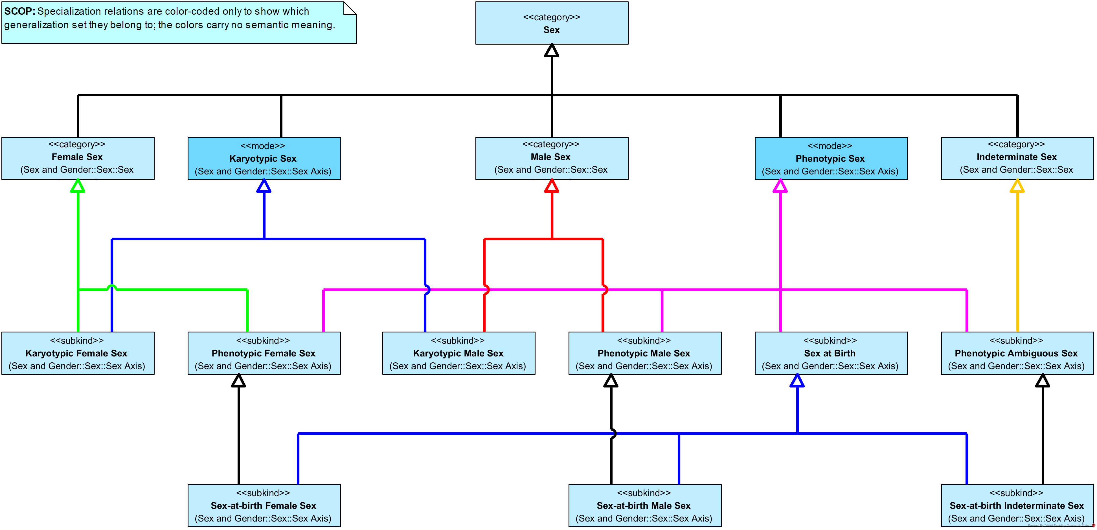
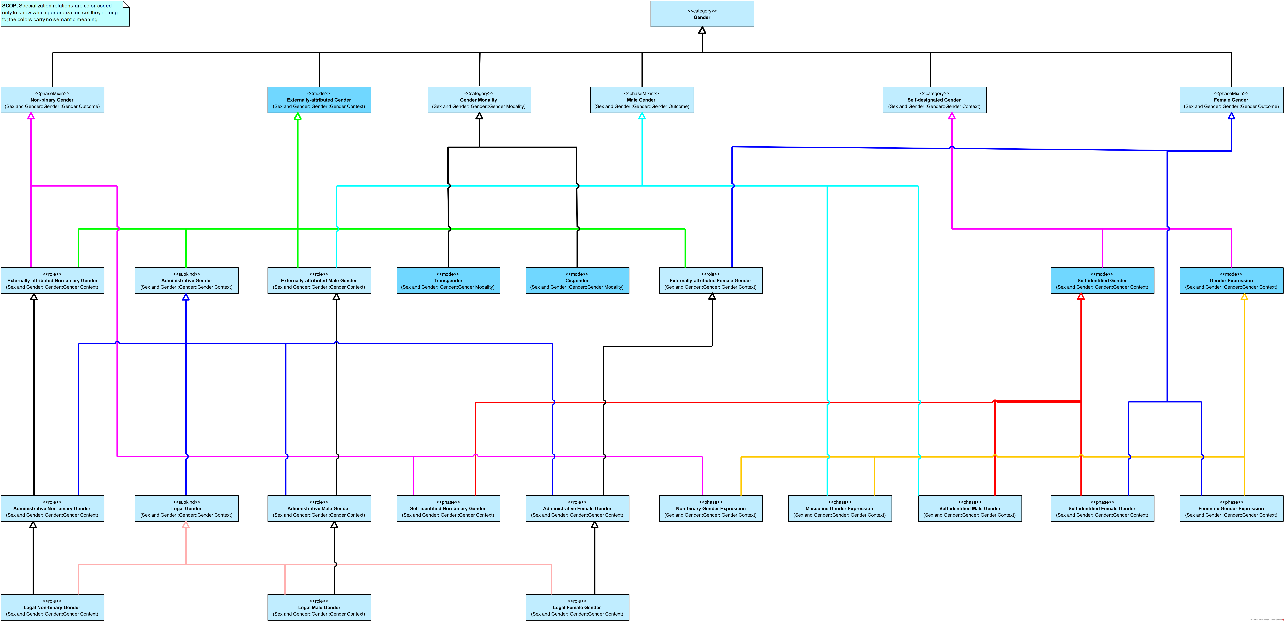
HRIO Taxonomies for Sex and Gender
Sex
Gender
Scenario 1
Notes:
Here we see the HRIO taxonomies for sex and gender.
The details of the diagrams are not the main focus for the audience at this point. What this slide shows is that HRIO organizes these meanings into clear taxonomies.
Instead of treating all sex- and gender-related variables as one flat group, HRIO separates them into precise categories and makes their distinctions explicit.
This gives Amir a reference structure for asking better questions. For example, instead of simply asking for “gender,” he can now see that there are different kinds of gender-related concepts, connected in different ways, and identify which one best fits his study.

Slide 14

Variables Map to Distinct Meanings
care-sm:Sex
“Biological sex”@en
hri-openehr:legal-gender
“Legal gender”@en
loinc:107454-1
“Administrative gender”@en
HRIO’s Sex
HRIO’s Legal Gender
HRIO’s Administrative Gender
Scenario 1
Notes:
With these distinctions in place, Amir can use HRIO to identify the intended meaning of each dataset variable.
Here, the Care-SM variable, labeled Biological sex, is linked to the HRIO’s Sex concept. The openEHR-based variable, labeled Legal gender, is linked to the HRIO’s Legal Gender concept. And the LOINC variable, labeled Administrative gender, is linked to the HRIO’s Administrative Gender concept.
The key point is that each variable keeps its original representation, but its meaning becomes explicit.

Slide 15
Similar Variables, Different Meanings
 | care-sm:Sex ("Biological sex"@en)
 | female
 | male
 | female
 | hri-openehr:legal-gender ("Legal gender"@en)
 | female
 | male
 | nonbinary
 | loinc:107454-1 ("Administrative gender"@en)
 | woman
 | man
 | non-binary
The variables may look comparable, but they are linked to different meanings and should not be treated as interchangeable.
Scenario 1
Notes:
We now return to the dataset variables from Amir’s scenario.
The variables may still look comparable because they contain familiar values such as female, male, woman, man, and non-binary.
But after Amir uses HRIO to identify the intended meaning of each variable, their differences become clear.
One variable is about biological sex. One is about legal gender. One is about administrative gender.
So the conclusion for this first scenario is clear: Amir should not treat these variables as interchangeable just because their labels or values look similar.
By making the meanings explicit, he can avoid label-based guessing and move toward a more defensible decision about which data can be reused for his study.

Slide 16
Scenario 2: Identify the dataset that represents the right meaning
Scenario 1: Clarify Meanings Before Reuse
Scenario 2: Identify the dataset that represents the right meaning
Result:
Amir could move from label-based guessing to query-supported reuse decisions, using meanings, mappings, and inferred knowledge to identify relevant variables, compare related concepts, and understand which ones align, partially overlap, or should not be reused together.
Scenario 3: Use Mappings to Connect Data and Infer Reuse Knowledge
Scenario 4: Query Semantic Knowledge Across Variables and Meanings
Notes:
We now move from Scenario 1 into Scenario 2.
In the first scenario, Amir clarified that sex- and gender-related variables can represent different meanings. In this scenario, he applies that understanding to a practical task: finding the dataset that contains the right variable for his study.
For Amir, the target meaning is biological sex. The question is no longer simply, “Which datasets contain a column whose label is related to sex?” The question is, “Which dataset contains the variable that represents biological sex?”

Slide 17
Amir’s Question and Challenge
What Amir wants
 | care-sm:Sex ("Biological sex"@en)
 | female
 | male
 | female
Find the datasets that contain the right variable for his study
Select the columns that represent biological sex
Build a cohort using data that fit his research question
 | hri-openehr:legal-gender ("Legal gender"@en)
 | female
 | male
 | nonbinary
Amir’s challenge
Several datasets may appear relevant at first glance.
However, the visible sex/gender-related columns represent different meanings, so he cannot choose safely from labels alone.
 | loinc:107454-1 ("Administrative gender"@en)
 | woman
 | man
 | non-binary
“Which of these datasets contains the variable that represents biological sex?”
Scenario 2
Notes:
In this scenario, Amir wants to identify the datasets that contain the right variable for his study: a column representing biological sex.
Several datasets may look relevant at first glance. They all contain sex- or gender-related columns, and some of their values may look familiar. But Amir knows that visible labels alone are not enough.
So the question becomes: which of these datasets contains the variable that actually represents biological sex?

Slide 18
When are two datasets interoperable?
When can two datasets be safely reused together?
When their relevant columns implement the same standard concept.
However, this works only if (1) the standard concept is well defined, and
(2) the datasets implement it correctly.
C2
C1
C3
Standard Concepts
D1
D2
D3
D4
Dataset Columns
Scenario 2
Notes:
To understand the problem more generally, we start with a simple question: when can two datasets be safely reused together?
At the bottom, we have dataset columns. At the level above, we have standard concepts. A dataset column may implement a concept from a standard.
When the relevant columns from different datasets implement the same standard concept, that shared concept can provide a useful point of alignment.
However, this only works under two important conditions: the standard concept must be well defined, and the datasets must implement it correctly.
So, this model can support interoperability, but only when the shared standard concept is sufficiently precise and reliably used.

Slide 19
When are two datasets interoperable?
Can D1 and D2 be safely reused together?
Without explicit meanings, we can only see interoperability when datasets share the same standard concept.
C2
C1
C3
Standard Concepts
D1
D2
D3
D4
Dataset Columns
Scenario 2
Notes:
The next question is: what happens when two dataset columns do not implement the same standard concept? For example, can D1 and D2 be compared or combined safely?
If both columns point to the same well-defined standard concept, we have visible evidence of alignment. But if that shared concept is missing, indirect, or unclear, then interoperability is harder to assess.
Without explicit meanings, we can only see interoperability when datasets share the same standard concept.

Slide 20
Semantic Interoperability Conditions
We need precise and explicit meanings.
Meanings
M1
M2
If meanings differ, interoperability is not possible.
C2
C1
C3
Standard Concepts
*
D1
D2
D3
D4
Dataset Columns
Scenario 2
Notes:
Now we make the condition for semantic interoperability more explicit.
D1 and D2 may both appear relevant, and their concepts may belong to the same broad area. But once we look at the meanings layer, we see that they point to different meanings.
That difference matters. If the concepts do not share the same meaning, then the variables cannot be safely reused together.
So for Amir, this is a negative result: without shared meaning, these variables should not be treated as interoperable for his study.

Slide 21
Semantic Interoperability Conditions
We need precise and explicit meanings.
Meanings
M1
M2
If meanings differ, interoperability is not possible.
If the concepts share the same meaning, interoperability is possible.
C2
C1
C3
Standard Concepts
*
D1
D2
D3
D4
Dataset Columns
Scenario 2
Notes:
Now we see the positive case.
D1 and D2 are connected to concepts that share the same meaning. This gives us a semantic basis for comparing or reusing them together.
However, semantic compatibility is only one part of interoperability. It is necessary, but not sufficient. Other aspects still matter, such as structure, values, formats, and implementation details.
So the conclusion here is cautious but positive: D1 and D2 meet the necessary condition for interoperability.

Slide 22
From Conceptual Clarity to Actionable Semantics
The meanings are now clear in the conceptual model, but Amir still cannot query or compute over them directly.
The next step is to turn these conceptual meanings into machine-readable, queryable, and actionable relations.
hrio:Sex
hrio:LegalGender
hrio:AdministrativeGender
Meanings
care-sm:Sex
hri-openehr:legal-gender
loinc:107454-1
Standard Concepts
NPR Demographic
Extract
Hospital Registration
Extract
Administrative Intake
Extract
Dataset Columns
Scenario 2
Notes:
Back in Amir’s situation.
At this point, the relevant meanings are clear in the conceptual model. Amir can see which concepts represent biological sex, legal gender, or administrative gender.
However, this still leaves Amir with a practical limitation. The meanings are known, but they are not yet computationally actionable.
The next step is to turn these conceptual meanings into machine-readable, queryable, and actionable relations.

Slide 23
The Health-RI Computational Ontology
The Health-RI Semantic Interoperability Initiative
1
Conceptual clarification:
Meanings are precise and explicit
HRIM
Mapping Set
HRIO
Conceptual
2
Computational tractability:
Machine-readable relations
HRIO
Computational
Scenario 2
Notes:
In the previous scenario, we introduced HRIO as a way to support conceptual clarification. It helped make meanings precise and explicit. But we now move from conceptual clarification to computational tractability.
This is where the computational version of HRIO comes in. It represents the relevant meanings and their relations in machine-readable form, so they can be queried, processed, and reused.
In other words, the computational ontology turns conceptual distinctions into something that can support Amir’s dataset discovery task.

Slide 24
From Conceptual Clarity to Actionable Semantics
Amir can now query for dataset columns that are mapped to the meaning he needs: HRIO’s Sex.
input
hrio:Sex
hrio:LegalGender
hrio:AdministrativeGender
Meanings
SELECT DISTINCT ?output
WHERE {
VALUES ?input { hrio:Sex }
?mapping a demo:Mapping ;
demo:hasMappingSource ?concept ;
demo:hasTargetMeaning ?input .
?output demo:implementsConcept ?concept .
}
ORDER BY ?output
care-sm:Sex
hri-openehr:legal-gender
loinc:107454-1
Standard Concepts
NPR Demographic
Extract
Hospital Registration
Extract
Administrative Intake
Extract
Dataset Columns
output
Scenario 2
Notes:
We now reach the result of Scenario 2.
The meanings are now not only clear, but also computationally actionable. Amir can query for dataset columns that are mapped to the meaning he needs: biological sex, represented here as HRIO’s Sex.
In this example, the query returns the NPR Demographic Extract, because its column is mapped to the biological sex meaning.
So, Amir no longer has to rely only on labels or manual inspection. He can use explicit, machine-readable semantic relations to identify the dataset that contains the right variable for his study.

Slide 25
Scenario 3: Use Mappings to Connect Data and Infer Reuse Knowledge
Scenario 1: Clarify Meanings Before Reuse
Scenario 2: Identify the dataset that represents the right meaning
Result:
Amir could move from label-based guessing to query-supported reuse decisions, using meanings, mappings, and inferred knowledge to identify relevant variables, compare related concepts, and understand which ones align, partially overlap, or should not be reused together.
Scenario 3: Use Mappings to Connect Data and Infer Reuse Knowledge
Scenario 4: Query Semantic Knowledge Across Variables and Meanings

Slide 26
Amir’s Question and Challenge
What Amir wants
 | care-sm:Sex ("Biological sex"@en)
 | female
 | male
 | female
Understand how dataset variables are connected to explicit meanings
Reuse existing mappings instead of interpreting each variable manually
See how added mappings can create more knowledge for future reuse
Amir’s challenge
 | hri-openehr:legal-gender ("Legal gender"@en)
 | female
 | male
 | nonbinary
The meanings are now explicit and machine-readable, but Amir still needs to understand how dataset variables, standard concepts, and meanings are connected.
To support reuse, those links must be captured as reusable mappings rather than treated as one-off interpretations.
 | loinc:107454-1 ("Administrative gender"@en)
 | woman
 | man
 | non-binary
“How can mappings help Amir connect concepts, meanings, and datasets to infer new reuse knowledge?”

Slide 27
External Mappings
source_CURIE | source_label | target_CURIE | target_label
cdisc-sdtm:DM.SEX | Sex | care-sm:Sex | Biological sex
ncit:C28421 | Sex | care-sm:Sex | Biological sex
 | care-sm:Sex ("Biological sex"@en)
 | female
 | male
 | female
Clinical Research Standards Mapping Community
source_CURIE | source_label | target_CURIE | target_label
npr:person.sex_code | Registered biol. sex | care-sm:Sex | Biological sex
npr:person.sex_code | Registered biol. sex | registry:resident.sex | Resident sex
fhir:Patient.gender | Administrative gender | hl7v3:AdmGender | Administrative gender
 | hri-openehr:legal-gender ("Legal gender"@en)
 | female
 | male
 | nonbinary
Dutch Health Data Stewardship Community
 | loinc:107454-1 ("Administrative gender"@en)
 | woman
 | man
 | non-binary
source_CURIE | source_label | target_CURIE | target_label
loinc:107454-1 | Administrative gender | fhir:Patient.gender | Administrative gender
loinc:107454-1 | Administrative gender | hl7v2:0001 | Administrative sex
Administrative Gender Standards Community

Slide 28
Pairwise Mappings Require Multiple Steps
Without a meaning layer, reuse depends on chains of concept-to-concept mappings.
These mappings are often fragile and label-driven.
Each new concept adds complexity, making maintenance harder.
source_CURIE | target_CURIE
cdisc-sdtm:DM.SEX | care-sm:Sex
ncit:C28421 | care-sm:Sex
A
C
B
From E to A: 3 steps
From J to A: 4 steps
source_CURIE | target_CURIE
npr:person.sex_code | care-sm:Sex
npr:person.sex_code | registry:resident.sex
fhir:Patient.gender | hl7v3:AdmGender
D
E
A
E
F
I
F
Standard Concepts
C
J
H
source_CURIE | target_CURIE
loinc:107454-1 | fhir:Patient.gender
loinc:107454-1 | hl7v2:0001
H
G
B
D
G
I

Slide 29
The Health-RI SSSOM Mapping Set (HRIM)
The Health-RI Semantic Interoperability Initiative
HRIM
Mapping Set
HRIO
Conceptual
HRIO
Computational
Semantic mappings move reuse
from fragile pairwise mappings
to a hub-and-spoke model.
3

Slide 30
Meaning-Based Mappings Shorten Reuse Paths
From E to A: 2 steps
Shared meanings create a common semantic hub. Paths are shorter and clearer.
Semantic alignment is based on explicit meanings, not labels.
Adding concepts creates more reusable knowledge for future queries, enriching the network without increasing path complexity.
From J to A: 2 steps
Meanings
X
Y
A
E
F
I
Standard Concepts
C
J
H
B
D
G

Slide 31
From Mappings to Inferred Knowledge
Legend
hasMeaning
narrowerThan
Meanings
aligns
cannotAlign
partiallyAlign
Standard Concepts

Slide 32
Amir Assesses Reuse Through Semantic Relations
Biological sex does not align with the gender-based datasets.
Legal gender and administrative gender are related, but only partially align.
Amir can now rule out unsafe reuse.
hrio:Sex
hrio:LegalGender
hrio:AdministrativeGender
Meanings
care-sm:Sex
hri-openehr:legal-gender
loinc:107454-1
Standard Concepts
NPR Demographic
Extract
Hospital Registration
Extract
Administrative Intake
Extract
Dataset Columns
Scenario 2
Notes:
Back in Amir’s situation.
At this point, the relevant meanings are clear in the conceptual model. Amir can see which concepts represent biological sex, legal gender, or administrative gender.
However, this still leaves Amir with a practical limitation. The meanings are known, but they are not yet computationally actionable.
The next step is to turn these conceptual meanings into machine-readable, queryable, and actionable relations.

Slide 33
Scenario 4: Query Semantic Knowledge Across Variables and Meanings
Scenario 1: Clarify Meanings Before Reuse
Scenario 2: Identify the dataset that represents the right meaning
Result:
Amir could move from label-based guessing to query-supported reuse decisions, using meanings, mappings, and inferred knowledge to identify relevant variables, compare related concepts, and understand which ones align, partially overlap, or should not be reused together.
Scenario 3: Use Mappings to Connect Data and Infer Reuse Knowledge
Scenario 4: Query Semantic Knowledge Across Variables and Meanings

Slide 34
Amir’s Question and Challenge
What Amir wants
 | care-sm:Sex ("Biological sex"@en)
 | female
 | male
 | female
Query dataset variables with semantic context
Use mappings to reveal available variables and data
Leverage inferred knowledge for data reuse
Amir’s challenge
 | hri-openehr:legal-gender ("Legal gender"@en)
 | female
 | male
 | nonbinary
Mappings connect dataset variables, standard concepts, and meanings, but the value comes from querying them.
The semantic knowledge is available, but Amir still needs to query it in ways that produce useful evidence for reuse decisions.
 | loinc:107454-1 ("Administrative gender"@en)
 | woman
 | man
 | non-binary
How can semantic knowledge become practical support for Amir’s data reuse decisions?

Slide 35
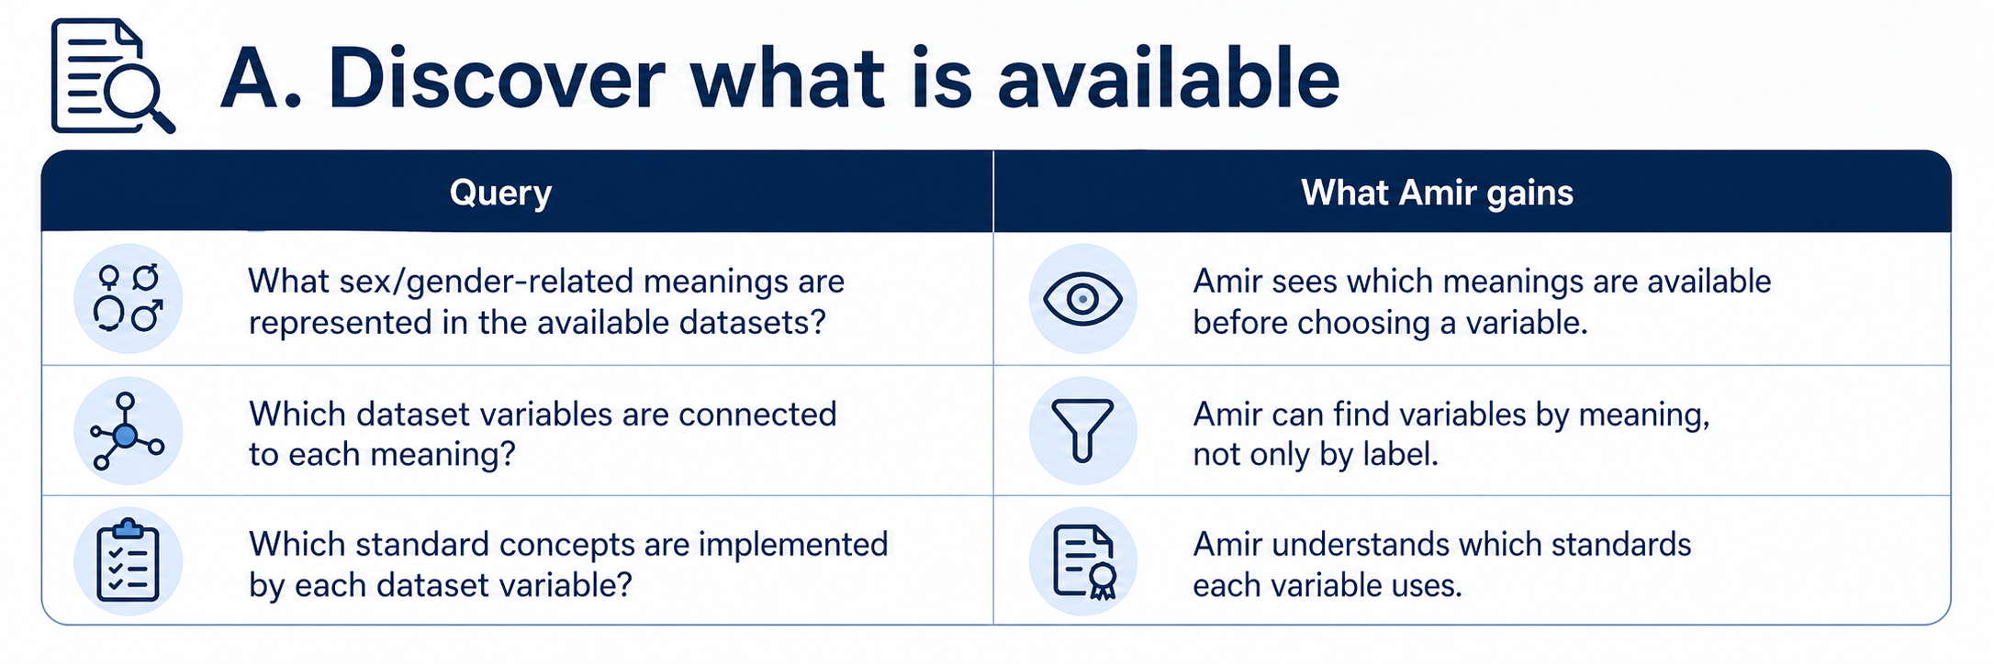
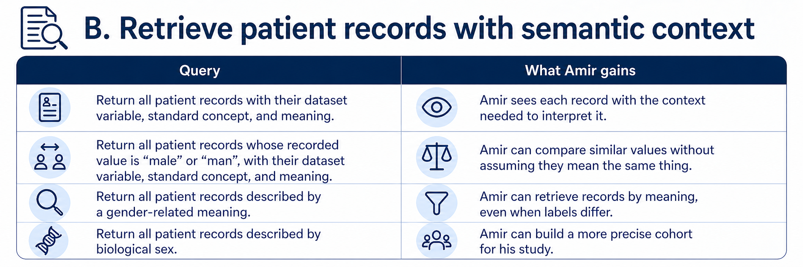
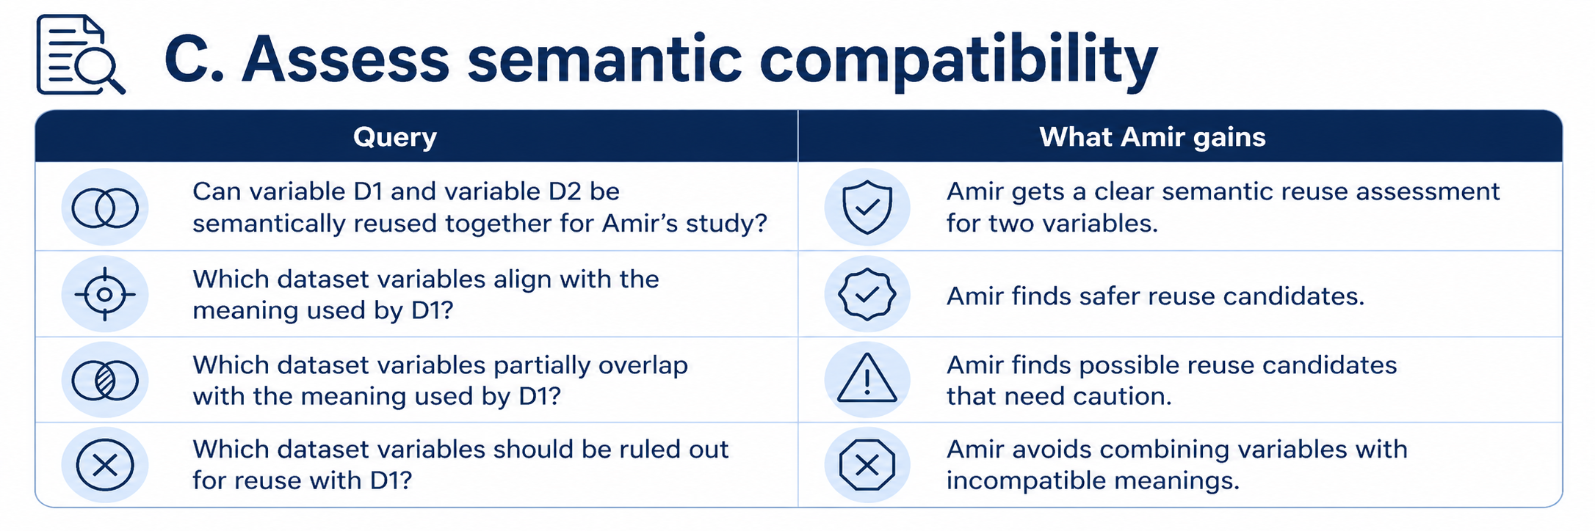
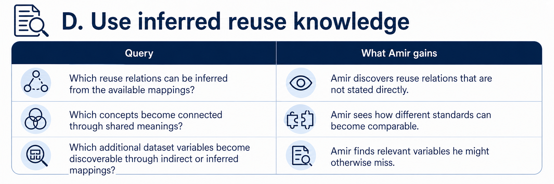
Amir’s Possible Queries

Slide 36
Result of Amir’s Workflow
Scenario 1: Clarify Meanings Before Reuse
Scenario 2: Identify the dataset that represents the right meaning
Result:
Amir could move from label-based guessing to query-supported reuse decisions, using meanings, mappings, and inferred knowledge to identify relevant variables, compare related concepts, and understand which ones align, partially overlap, or should not be reused together.
Scenario 3: Use Mappings to Connect Data and Infer Reuse Knowledge
Scenario 4: Query Semantic Knowledge Across Variables and Meanings

Slide 37
Inge de Boer: Data Steward Goal and Challenge
Inge is responsible for curating dataset metadata and semantic mappings across institutions and needs to ensure that sex/gender-related variables are described accurately.
Before publishing or reusing mappings, she must verify whether similar-looking variables actually mean the same thing, detect inconsistencies, and prevent unsafe alignments from propagating across the semantic layer.
Dr. Amir Hassan — Researcher

Slide 38
Inge de Boer: Data Steward Goal and Challenge
Scenario:
Validate Consistency for Safe Data Reuse
Dr. Amir Hassan — Researcher

Slide 39
Inge’s Question and Challenge
What Inge wants
 | care-sm:Sex ("Biological sex"@en)
 | female
 | male
 | female
Validate semantic metadata before publication
Check dataset variables, standard concepts, meanings, and mappings
Publish reusable knowledge with confidence
Inge’s challenge
 | hri-openehr:legal-gender ("Legal gender"@en)
 | female
 | male
 | nonbinary
Mappings and meanings must be checked together, not reviewed as isolated labels.
Dataset variables and standard concepts can be connected incorrectly if validation happens too late.
 | loinc:107454-1 ("Administrative gender"@en)
 | woman
 | man
 | non-binary
How can Inge validate whether dataset variables, standard concepts, meanings, and mappings are consistent to publish and reuse?

Slide 40
Inconsistent Meaning Assignments
Legend
hasMeaning
NOT hasMeaning
Meanings
consistent
inconsistent
Standard Concepts

Slide 41
New Proposed Mapping
proposed
mapping
source_CURIE | target_CURIE
cdisc-sdtm:DM.SEX | care-sm:Sex
ncit:C28421 | care-sm:Sex
A
C
B
Meanings
source_CURIE | target_CURIE
npr:person.sex_code | care-sm:Sex
npr:person.sex_code | registry:resident.sex
fhir:Patient.gender | hl7v3:AdmGender
D
E
A
E
F
I
F
Standard Concepts
C
K
H
source_CURIE | target_CURIE
loinc:107454-1 | fhir:Patient.gender
loinc:107454-1 | hl7v2:0001
hri-openehr:
legal-gender
H
G
K
B
D
G
I

Slide 42
Consistency Assessment Results
proposed
mapping
source_CURIE | target_CURIE
cdisc-sdtm:DM.SEX | care-sm:Sex
ncit:C28421 | care-sm:Sex
A
C
B
Meanings
source_CURIE | target_CURIE
npr:person.sex_code | care-sm:Sex
npr:person.sex_code | registry:resident.sex
fhir:Patient.gender | hl7v3:AdmGender
D
E
A
E
F
I
F
Standard Concepts
C
K
H
source_CURIE | target_CURIE
loinc:107454-1 | fhir:Patient.gender
loinc:107454-1 | hl7v2:0001
hri-openehr:
legal-gender
H
G
K
B
D
G
I
Notes:
Inge receives three proposed semantic alignments.
She validates whether each proposal is consistent with the existing mappings and meaning assignments, and decides whether it is safe to publish.

Slide 43

Thank you!
https://w3id.org/
health-ri/semantic-interoperability
Pedro Paulo F. Barcelos, PhD {pedro.barcelos@health-ri.nl}

Slide 45
Context: Inference of Meaning-Relations
N-pairwise mappings
source_CURIE | target_CURIE
cdisc-sdtm:DM.SEX | care-sm:Sex
ncit:C28421 | care-sm:Sex
source_CURIE | target_CURIE
npr:person.sex_code | care-sm:Sex
npr:person.sex_code | registry:resident.sex
fhir:Patient.gender | hl7v3:AdmGender
Standard Concepts
source_CURIE | target_CURIE
loinc:107454-1 | fhir:Patient.gender
loinc:107454-1 | hl7v2:0001

Slide 46
Context: Inference of Meaning-Relations
Legend
hasMeaning
narrowerThan
Meanings
aligns
cannotAlign
partiallyAlign
Standard Concepts

Slide 47
Scenario 4: Formalize the semantic relation between two selected columns
Scenario 1: Clarify Meanings Before Reuse
Scenario 2: Identify the dataset that represents the right meaning
Scenario 3: Inspect what a selected column means
Scenario 4: Formalize the semantic relation between two selected columns
Scenario 5: Assess (re)use options around one selected concept
Result: Amir could move from label-based guessing to a defensible decision, identifying which variable fits his study and which related concepts align, should be ruled out, or only partially overlap.

Slide 48
Amir’s Question and Challenge
What Amir wants
 | care-sm:Sex ("Biological sex"@en)
 | female
 | male
 | female
Verify the formal relation between two selected variables
Translate semantic understanding into a documented reuse decision
Make his inclusion and exclusion choices easier to explain and defend
 | hri-openehr:legal-gender ("Legal gender"@en)
 | female
 | male
 | nonbinary
Amir’s challenge
The different meanings are now clear to Amir. However, to document the outcome of his analysis properly, he needs the semantic layer to state the formal relation between the two selected columns.
 | loinc:107454-1 ("Administrative gender"@en)
 | woman
 | man
 | non-binary
“What is the semantic relation between care-sm:Sex and hri-fhir-r5:individual-gender-identity/value?”

Slide 49
Context: Inference of Meaning-Relations
Legend
hasMeaning
narrowerThan
Meanings
aligns
cannotAlign
partiallyAlign
Standard Concepts

Slide 50
Context: With HRI-SSI
Amir: “What is the semantic relation between care-sm:Sex
and hri-fhir-r5:individual-gender-identity/value?”
hrio:Sex
hrio:SelfIdentifiedGender
Meanings
input
care-sm:Sex
hri-fhir-r5:
individual-gender-identity/value
Standard Concepts
BRP Demographic
Extract
Administrative EHR Extract
Datasets Columns

Slide 51
Scenario 4 — Check the Existing Alignment Between Two Selected Concepts
SELECT DISTINCT ?relationType
WHERE {
VALUES (?sourceConcept ?targetConcept) {
(https://w3id.org/CARE-SM#Sex hri-fhir-r5:individual-gender-identity/value)
}
VALUES ?relationType { demo:aligns demo:mayAlign demo:partiallyAligns demo:cannotAlign }
{ ?sourceConcept ?relationType ?targetConcept }
UNION
{ ?targetConcept ?relationType ?sourceConcept }
}
ORDER BY ?relationType

Slide 52
Scenario 5: Assess (re)use options around one selected concept
Scenario 1: Clarify Meanings Before Reuse
Scenario 2: Identify the dataset that represents the right meaning
Scenario 3: Inspect what a selected column means
Scenario 4: Formalize the semantic relation between two selected columns
Scenario 5: Assess (re)use options around one selected concept
Result: Amir could move from label-based guessing to a defensible decision, identifying which variable fits his study and which related concepts align, should be ruled out, or only partially overlap.

Slide 53

Amir’s Question and Challenge
What Amir wants
See all relevant semantic relations around his selected concept in one view
Distinguish exact matches from invalid candidate connections and partial overlaps
Make a defensible decision about which possible links are valid and which should be ruled out
Amir’s challenge
A single pairwise comparison is no longer enough.
What he needs now is not another isolated comparison, but a complete result showing which concepts align, which should be ruled out, and which only partially align with his selected variable.
What is the (re)use landscape around
my selected concept?

Slide 54
Context: Without HRI-SSI
Can D1 and D2 interoperate? How can we check that?
We can rely on existing mappings and infer relations
C2
C4
C6
C1
C3
C5
Standard Concepts
D2
D4
D1
D3
D5
Dataset Columns

Slide 55
Context: Without HRI-SSI
From C2: aligns C3 (asserted) and aligns C4 (inferred)
Can D1 and D2 interoperate? How can we check that?
We can rely on existing mappings and infer relations
C2
C4
C6
C1
C3
C5
Standard Concepts
D2
D4
D1
D3
D5
Dataset Columns

Slide 56
Context: With HRI-SSI (aligns)
narrowerMeaning
(subClassOf)
C1
C2
C3
Meanings
C2
C4
C6
C1
C3
C5
Standard Concepts
D2
D4
D1
D3
D5
Dataset Columns

Slide 57
Context: With HRI-SSI (cannotAlign)
narrowerMeaning
(subClassOf)
C1
C2
C3
Meanings
C2
C4
C6
C1
C3
C5
Standard Concepts
D2
D4
D1
D3
D5
Datasets Columns

Slide 58
Context: With HRI-SSI (partiallyAlign)
narrowerMeaning
(subClassOf)
C1
C2
C3
Meanings
C2
C4
C6
C1
C3
C5
Standard Concepts
D2
D4
D1
D3
D5
Dataset Columns

Slide 59
Context: With HRI-SSI results
From C2:
aligns C3 (asserted) and aligns C4 (inferred)
cannotAlign C5 and C6 (inferred)
partiallyAligns C1(inferred)
narrowerMeaning
(subClassOf)
C1
C2
C3
Meanings
C2
C4
C6
C1
C3
C5
Standard Concepts
D2
D4
D1
D3
D5
Dataset Columns

Slide 60
Scenario 5: query
SELECT DISTINCT
?relatedConcept ?relationType
WHERE {
VALUES ?focusConcept {
<FOCUS_CONCEPT_URI>
}
VALUES ?relationType { demo:aligns demo:partiallyAligns demo:cannotAlign }
?focusConcept ?relationType ?relatedConcept .
FILTER(?relatedConcept != ?focusConcept)
}
ORDER BY ?relationType ?relatedConcept

Slide 61
SCENARIO 4: Can D1 with D2 interoperate? Returns YES, NO, PARTIAL
 | care-sm:Sex ("Biological sex"@en)
 | female
 | male
 | female
 | hri-openehr:legal-gender ("Legal gender"@en)
 | female
 | male
 | nonbinary
 | loinc:107454-1 ("Administrative gender"@en)
 | woman
 | man
 | non-binary
Scenario 1

Slide 62
SCENARIO 3: Return the different types of meanings that all patients may have
Will return hrio:Sex, hrio:AdministrativeGender, hrio:SelfIdentifiedGender
SCENARIO 3: Return all patients, their concept and meaning
 | care-sm:Sex ("Biological sex"@en)
 | female
 | male
 | female
SCENARIO 3: Return all {male|man} patients, their concept and meaning
 | hri-openehr:legal-gender ("Legal gender"@en)
 | female
 | male
 | nonbinary
 | loinc:107454-1 ("Administrative gender"@en)
 | woman
 | man
 | non-binary
Scenario 1

Slide 63
SCENARIO 2: Return all patients that are defined by social gender
Query all patients that implement concepts that have meaning hrio:Gender or one of its subclasses
Will return all instances from D2 and D3.
 | care-sm:Sex ("Biological sex"@en)
 | female
 | male
 | female
 | hri-openehr:legal-gender ("Legal gender"@en)
 | female
 | male
 | nonbinary
 | loinc:107454-1 ("Administrative gender"@en)
 | woman
 | man
 | non-binary
Scenario 1

Slide 64
SCENARIO 5: With which datasets can D1 interoperate (CHECK FOR ALIGNS)?
SCENARIO 5: What are potential candidates for D1 interoperability (check for PARTIAL)?
SCENARIO 5: Return all patients from datasets that implements the same concept that my variable care-sm:Sex implements.
returns: id, datasets
 | care-sm:Sex ("Biological sex"@en)
 | female
 | male
 | female
 | hri-openehr:legal-gender ("Legal gender"@en)
 | female
 | male
 | nonbinary
 | loinc:107454-1 ("Administrative gender"@en)
 | woman
 | man
 | non-binary
Scenario 2

Slide 65
Meaning
Standard Concepts
Dataset Columns

Slide 66
Without Meanings: Labels are not Enough
Amir: “Which of these datasets contains the variable that represents biological sex?”
Meanings
M1
C2
C1
C3
Standard Concepts
D1
D2
D3
D4
Dataset Columns
Scenario 2

Slide 67
Without Meanings: Interpretation or Unreliable Mappings
Biological Sex
Amir: “Which of these datasets contains the variable that represents biological sex?”
Meanings
Two approaches are possible: perform (costly/error-prone) interpretation and assessments, or rely on existing but potentially unreliable mappings.
reliable mapping
(after analysis)
C2
C1
inferred mapping
unreliable mapping
(externally provided)
C3
Standard Concepts
D1
D2
D3
D4
Dataset Columns
Scenario 2

Slide 68
With Meanings: Hub-and-Spoke Model
Biological Sex
Amir: “Which of these datasets contains the variable that represents biological sex?”
Meanings
Explicit, precise, machine-processable meanings;
a hub-and-spoke model; centralized querying; and reuse of available but unreliable mappings.
C2
C1
inferred mapping
unreliable mapping
(externally provided)
C3
Standard Concepts
D1
D2
D3
D4
Dataset Columns
Scenario 2

Slide 69
Amir’s Story
Scenario 1:
Clarify Meanings Before Reuse
Scenario 5:
Assess (re)use options around one selected concept
Result: Amir could move from label-based guessing to a defensible decision, identifying which variable fits his study and which related concepts align, should be ruled out, or only partially overlap.
Scenario 2:
Identify the dataset that represents the right meaning
Scenario 3:
Inspect what a selected column means
Scenario 4:
Formalize the semantic relation between two selected columns

Slide 70
User: Inge de Boer — Data Steward
Scenario 6 — validate one concept
Scenario 7 — review all inconsistencies
Scenario 8 — simulate consequences before publication
TO BE UPDATED
Dr. Amir Hassan — Researcher

Slide 71
Inge’s Data
Inge is reviewing draft mappings for sex/gender-related variables before they are published into the semantic layer.
Some proposals look plausible from labels alone, but she needs to verify whether they are semantically correct, consistent, and safe to reuse.
Inge receives from XXX a proposed mapping:
 | care-sm:Sex ("Biological sex"@en)
 | female
 | male
 | female
 | hri-openehr:legal-gender ("Legal gender"@en)
 | female
 | male
 | nonbinary
hri-openehr:administrative-gender
skos:exactMatch
hri-fhir-r5:individual-gender-identity/value
 | loinc:107454-1 ("Administrative gender"@en)
 | woman
 | man
 | non-binary

Slide 72
Context: Without HRI-SSI
Same problem as before
Meanings
proposed alignment
C2
By applying the proposed mapping:
- If they map the same meaning, consistent
- If they map different meanings, inconsistent
C1
Standard Concepts
D1
D2
D3
Datasets Columns

Slide 73
Context: With HRI-SSI
By applying the proposed mapping:
- If they map the same meaning, consistent
- If they map different meanings, inconsistent
C1
C2
Meanings
proposed alignment rejected
C2
It is clear that they refer to different concepts, so the mapping is rejected, keeping the consistency of the dataset.
C1
Standard Concepts
D1
D2
D3
Datasets Columns

Slide 74
Scenario 7 — Retrieve All Semantically Inconsistent Concepts

Slide 75
Scenario 8 — Assess the Consequences of a Proposed Alignment

Slide 76
Inge’s Story
Scenario 6 — validate one concept
Scenario 7 — review all inconsistencies
Scenario 8 — simulate consequences before publication

Slide 77
Meanings Are Necessary, but not Sufficient
Semantic alignment is necessary for interoperability, but it is not sufficient on its own.
Intersecting meanings
Disjoint meanings
Subset relation
Semantic relationship between concepts:
Strong overlap: interoperability is more likely, though full preservation of meaning is not guaranteed.
Partial overlap: interoperability is possible, but carries a significant risk of semantic distortion.
No overlap: semantic interoperability is not possible.
Scenario 2
Notes:
TO BE DONE.

Slide 78
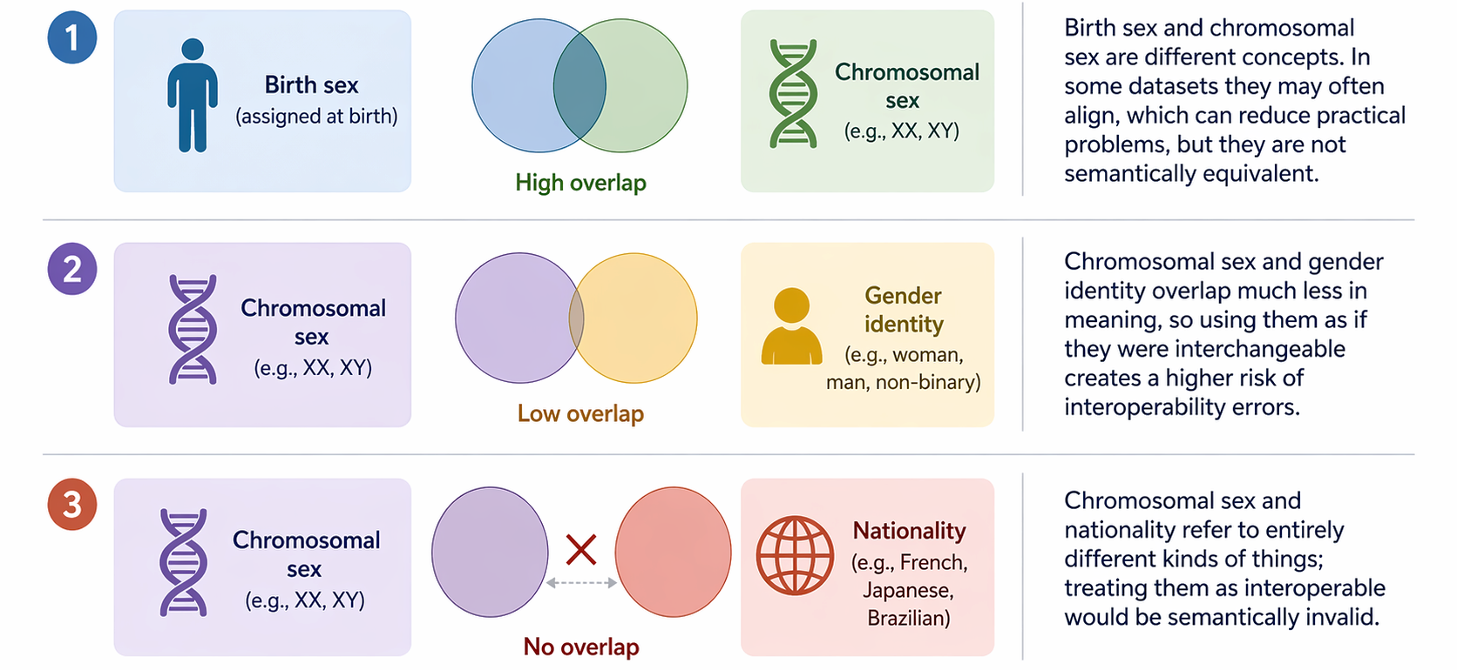
Examples of Semantic Similarity and Difference
Scenario 2
Notes:
TO BE DONE.

Slide 79
Exact Meaning is not Enough
If two concepts share exactly the same meaning, that supports semantic interoperability, but it still does not guarantee interoperability overall.
Exact meanings
Format/syntax:
JSON vs XML vs CSV
Data model/structure:
different fields, nesting, cardinalities
A=B
Value representation:
codes, labels, datatypes, date formats
Units/scales:
kg vs lb, Celsius vs Fahrenheit
Identifiers/references:
different IDs for the same entity
Constraints/business rules:
required fields, validation rules
Protocol/transport:
API, file exchange, messaging differences
Scenario 2
Notes:
TO BE DONE.

Slide 80
Specification Scales Better than Interpretation
Interpretation and Assessment
Specification and Implementation
Difficult and costly
Error-prone
Systematic
Structured
Non-deterministic (interpretation-driven)
Deterministic (specification-driven)
L2
L1
L0
Scenario 2

